Slide 1
Creating an Oracle Database Using DBCA

Slide 2
Objectives
After completing this lesson, you should be able to do the following:
  Create a database by using the Database Configuration Assistant (DBCA)
  Generate database creation scripts with the DBCA
  Manage database design templates with the DBCA
  Perform additional tasks with the DBCA

Slide 3

Planning the Database
As a DBA, you must plan:
  The logical storage structure of the database and its physical implementation:
    How many disk drives do you have? What type of storage is being used?
    How many data files will you need? (Plan for growth.)
    How many tablespaces will you use?
    What types of information will be stored?
    Are there any special storage requirements
    due to type or size?
  Overall database design
  Database backup strategy
Notes:
Planning the Database
It is important to plan how the logical storage structure of the database will affect system performance and various database management operations. For example, before creating any tablespaces for your database, you should know how many data files will make up the tablespace, what type of information will be stored in each tablespace, and on which disk drives the data files will be physically stored. Information such as the availability of network attached storage (NAS) and the bandwidth for the private storage network are important. If storage area networks (SAN) are going to be used, knowing how the logical volumes are configured and the stripe size is useful.
When planning the overall logical storage of the database structure, take into account the effects that this structure will have when the database is actually created and running. You may have database objects that have special storage requirements due to type or size.
In distributed database environments, this planning stage is extremely important. The physical location of frequently accessed data dramatically affects application performance.
During the planning stage, develop a backup strategy for the database. You can alter the logical storage structure or design of the database to improve backup efficiency. Backup strategies are introduced in a later lesson.

Slide 4
Databases: Examples
  General purpose or transaction processing:
    Online transaction processing (OLTP) system, for example a retail billing system for a software house or a nursery
  Custom:
    Multipurpose database (perhaps combined OLTP and data warehouse functionality)
  Data warehouse:
    Research and marketing data
    State or federal tax payments
    Professional licensing (doctors, nurses, and so on)
Notes:
Databases: Examples
Different types of databases have their own specific instance and storage requirements. Your Oracle database software includes templates for the creation of these different types of databases. Characteristics of these examples are the following:
General purpose: For general purpose or transaction processing usage such as working with transactions and storing them for a medium length of time
Custom: For customized databases that do not fit into the general purpose or data warehouse template
Data warehouse: For storing data for long periods and retrieving them in read operations
The information on this page and the previous one present considerations that you will encounter as a DBA. This course (in its entirety) is designed to help you address them.

Slide 5
Choosing the Appropriate Character Set
  The Oracle database supports different classes of character-encoding schemes:
    Single-byte character sets
      7-bit
      8-bit
    Multibyte character sets, including Unicode
  The character set is chosen at the time of database creation. Choose the character set that best meets your business requirements now and in the future because it can be difficult to change character sets later on.
  In general Unicode is recommended because it is the most flexible character set.
Notes:
Oracle Database 11g: Administration Workshop I 3 - <number>
Choosing the Appropriate Character Set
When computer systems process characters, they use numeric codes instead of the graphical representation of the character. An encoded character set maps numeric codes to characters that a computer or terminal can display and receive. Different character sets support different character repertoires. Because character sets are typically based on a particular writing script, they can support more than one language. However, script-based character sets are restricted in the sense that they are limited to groups of languages based on similar scripts. Universal character sets encompass most major scripts of the modern world and provide a more useful solution to multilingual support. For information about the Unicode standards, see the Web site at http:www.unicode.org.
The Oracle database supports three classes of encoding schemes: Single-byte, Varying-width multibyte, and Universal. Choose the correct character set that best meets your business requirements now and in the future because it can be difficult to change character sets later on. For best performance, choose a character set that avoids character set conversion and uses the most efficient encoding for the languages desired. Single-byte character sets result in better performance than multibyte character sets, and they also are the most efficient in terms of space requirements. However, single-byte character sets limit how many languages you can support. To choose your correct database character set, evaluate your current and future business requirements, as well as technical requirements (for example, the XML and Java standards require Unicode). In general, Oracle recommends the use of Unicode for all new databases, because it is the most flexible character set and avoids future conversions.

Slide 6
Notes:
Choosing the Appropriate Character Set (continued)
Single-Byte Character Sets
In a single-byte character set, each character occupies one byte. Single-byte 7-bit encoding schemes can define up to 128 (2⁷) characters; single-byte 8-bit encoding schemes can define up to 256 (2⁸) characters.
Examples of Single-Byte Schemes
7-bit character set:
American Standard Code for Information Interchange (ASCII) 7-bit American (US7ASCII)
8-bit character set:
International Organization for Standards (ISO) 8859-1 West European (WE8ISO8859P1)
DEC 8-bit West European (WE8DEC)
Extended Binary Coded Decimal Interchange Code (EBCDIC) Code Page 1144 8-bit Italian (I8EBCDIC1144)
Multibyte Character Sets
A varying-width multibyte character set is represented by one or more bytes per character. Multibyte character sets are commonly used for Asian language support. Some multibyte encoding schemes use the value of the most significant bit to indicate whether a byte represents a single byte or is part of a series of bytes representing a character. However, other character-encoding schemes differentiate single-byte from multibyte characters. A shift-out control code, sent by a device, indicates that any successive bytes are double-byte characters until a shift-in code is encountered. Shift-sensitive encoding schemes are used primarily on IBM platforms.
Unicode is a universal encoded character set that enables information from any language to be stored using a single character set. Unicode provides a unique code value for every character, regardless of the platform, program, or language.
The Unicode standard has been adopted by many software and hardware vendors. Many operating systems and browsers now support Unicode. Unicode is required by standards such as XML, Java, JavaScript, LDAP, and WML. It is also synchronized with the ISO/IEC 10646 standard.
Examples of Varying-Width Multibyte Schemes
Shift-JIS 16-bit Japanese (JA16SJIS)
MS Windows Code Page 950 with Hong Kong Supplementary Character Set HKSCS-2001 (ZHT16HKSCS)
Unicode 4.0 UTF-8 Universal character set (AL32UTF8) - a variable-width type of encoding and also a strict superset of ASCII.
Unicode (ALl16UTF16 – a 16-bit encoding of Unicode that is used by both Microsoft Windows 2000 and Windows XP.

Slide 7


How Are Character Sets Used?
  Oracle Net compares the client NLS_LANG setting to the character set on the server.
  If needed, conversion occurs automatically and transparently.
NLS_LANG
Oracle Net
Client
Server
Notes:
How Are Character Sets Used?
The NLS_LANG parameter defines a client terminal’s character-encoding scheme. Different clients can use different encoding schemes. Data passed between the client and the server is converted automatically between the two encoding schemes. The database’s encoding scheme should be a superset, or equivalent, of all the clients’ encoding schemes. The conversion is transparent to the client application.
When the database character set and the client character set are the same, the database assumes that the data being sent or received is of the same character set, so no validations or conversions are performed.
Character set conversion may be required in a client/server environment, if a client application resides on a different platform than the server and if the platforms do not use the same character-encoding schemes. Character data passed between the client and the server must be converted between the two encoding schemes. Character conversion occurs automatically and transparently through Oracle Net.

Slide 8
Problems to Avoid
Example:
No conversion occurs, because it does not seem to be required.
Issue: Invalid data are entered into the database.
NLS_LANG:
AL32UTF8
Oracle Net
Client
Windows English
Code page: WE8MSWIN1252
Server
Database character set:
AL32UTF8
Notes:
Problems to Avoid
Invalid data usually enters a database when the NLS_LANG parameter is not set properly on the client. The NLS_LANG value should reflect the encoding of the incoming data.
When the NLS_LANG parameter is set properly, the database can automatically convert incoming data from the client operating system.
When the NLS_LANG parameter is not set properly, the data entering the database is not converted properly.
For example, suppose that the database character set is AL32UTF8, the client is an English Windows operating system (code page: WE8MSWIN1252), and the NLS_LANG setting on the client is AL32UTF8. Data entering the database is encoded in WE8MSWIN1252 and is not converted to AL32UTF8 data because the NLS_LANG setting on the client matches the database character set. Thus the Oracle database assumes that no conversion is necessary, and invalid data is entered into the database.

Slide 9
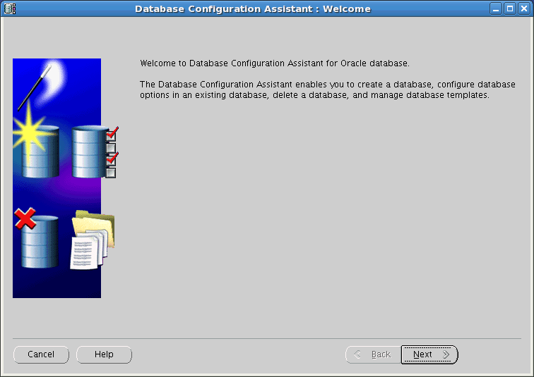
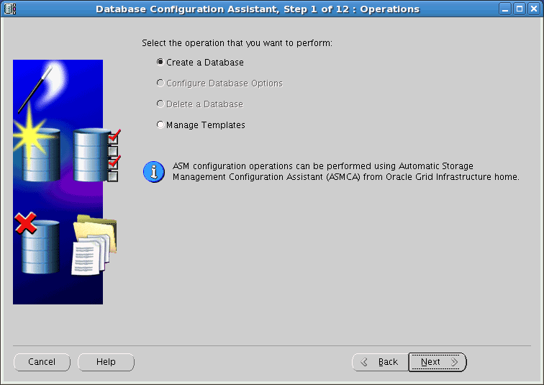
Database Configuration Assistant (DBCA)
1
2
Notes:
Oracle Database 11g: Administration Workshop I 3 - <number>
Database Configuration Assistant (DBCA)
The Database Configuration Assistant (DBCA) offers several choices to assist you with various operations. You can use the DBCA to create, change the configuration of, or delete a database. You can also create a database from a list of predefined templates or use an existing database as a sample to create a new database or template.
The DBCA provides several options to allow you to create a database to meet your needs. The DBCA provides a series of pages where you enter configuration information. On most pages, the DBCA provides default settings that you can accept if they apply. The steps involved in creating a database using the DBCA are as follows:
1. Log on to your computer as a member of the OS DBA group that is authorized to install the Oracle software. If required, set environment variables and enter dbca to invoke the DBCA. The main welcome page appears and you click Next to continue.
2. Choose the action you want to perform. In this case select Create a Database and click Next to begin that action.

Slide 10
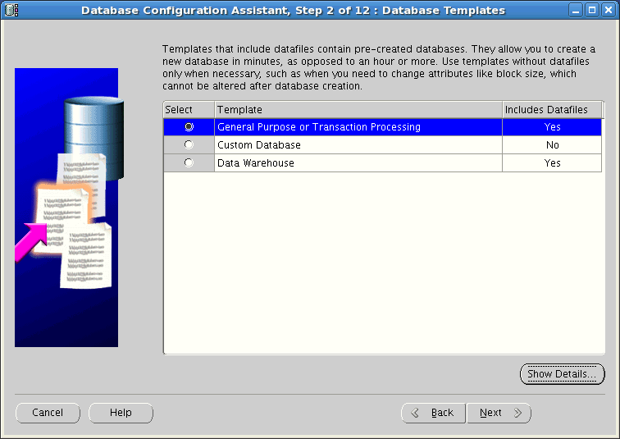
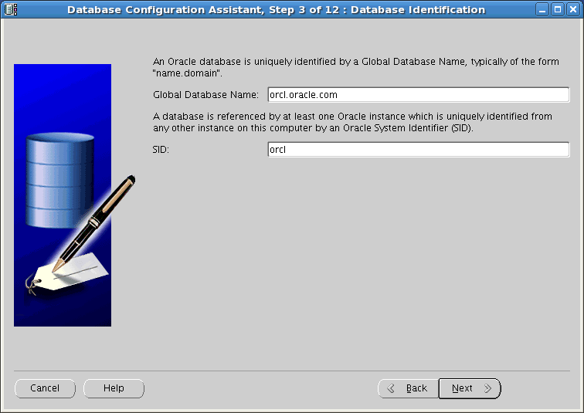
Using the DBCA to Create a Database
3
4
Notes:
Oracle Database 11g: Administration Workshop I 3 - <number>
Using the DBCA to Create a Database
3. Database Templates: Select the type of database template to be used in creating the database. There are three database templates (General Purpose or Transaction Processing, Custom Database, and Data Warehouse) that copy a preconfigured database, including the data files. These files include control files, redo log files, and data files for various included tablespaces. Click Show Details to see the configuration for each type of database.
For more complex environments, you may want to select the Custom Database option.
4. Database Identification: Enter the Global Database Name in the form database_name.domain_name, and the system identifier (SID). The SID defaults to the database name and uniquely identifies the instance associated with the database.

Slide 11
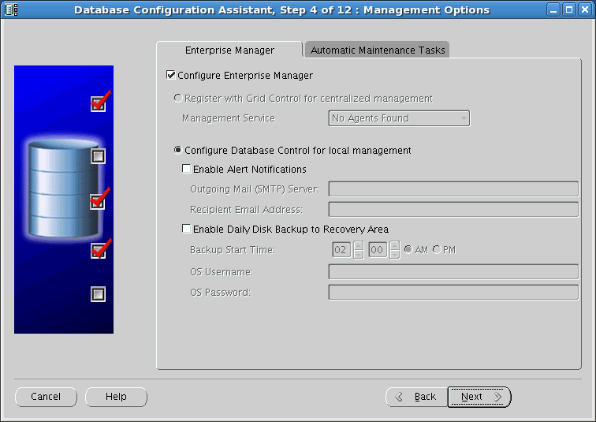
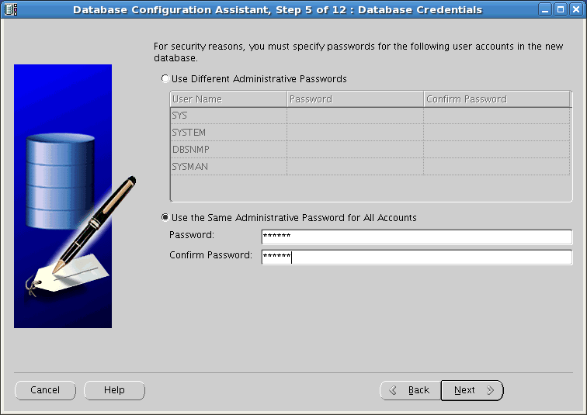
Using the DBCA to Create a Database
Enable automatic maintenance tasks such as optimizer statistic collection and proactive advisor reports.
5
6
Configuring Enterprise Manager for your database requires a listener to be configured as well.
Notes:
Oracle Database 11g: Administration Workshop I 3 - <number>
Using the DBCA to Create a Database (continued)
5. Management Options: Use this page to set up your database so that it can be managed with Oracle Enterprise Manager. Select the default: “Configure the Database with Enterprise Manager.” Optionally, this page allows you to configure alert notifications and daily disk backup area settings. The Register with Grid Control option is grayed-out if DBCA cannot detect an Enterprise Manager Grid Control agent to communicate with.
Note: Configuring Enterprise Manager for your database requires a listener to be configured as well (in our classroom the listener was configured during the installation of the Oracle Grid Infrastructure).
6. Database Credentials: Use this page to specify the passwords for the administrative accounts, such as SYS and SYSTEM. In class, use oracle_4U as the password for all administrative accounts.

Slide 12
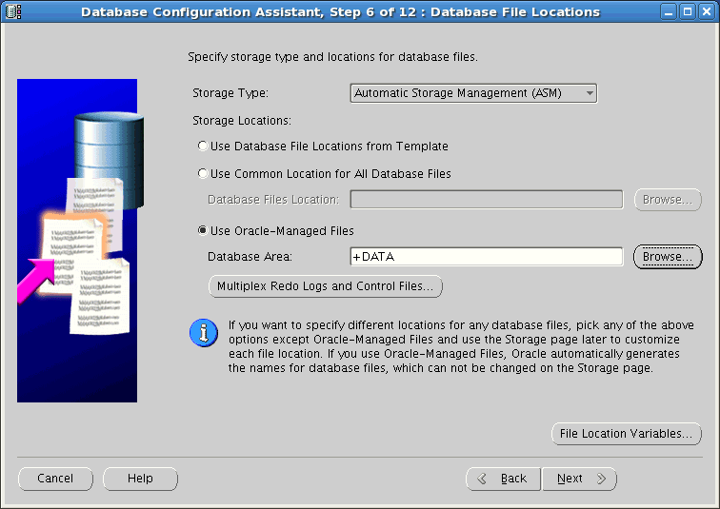
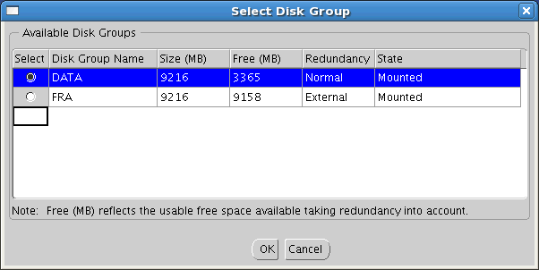
Using the DBCA to Create a Database
Choose between the file system or ASM (if ASM is available)
7
Create multiple copes of your redo logs and control files if desired.
8
Adjust file location variables (ORACLE_BASE, ORACLE_HOME, DB_NAME, DB_UNIQUE_NAME, SID) if needed.
Notes:
Oracle Database 11g: Administration Workshop I 3 - <number>
Using the DBCA to Create a Database (continued)
7. Database File Locations: Specify the type of storage mechanism (such as Automatic Storage Management (ASM) or File System) that you want your database to use. For Storage Location, choose according to your needs. In our example ASM is the storage mechanism so Oracle-Managed Files (OMF) is used. The Browse button allows you to view the available disk groups and choose the most appropriate disk group (+DATA is chosen in the example on the slide). You will be asked to provide the ASMSNMP password specific to ASM after you select the disk group. Oracle Managed Files (OMF) can be used with file system storage as well, eliminating the need for you to directly manage the operating system files in an Oracle database. If desired you can create additional copies of the redo logs and controls files by clicking the Multiplex Redo Logs and Control Files Button. A button is also provided to allow you to adjust the file location variables: ORACLE_BASE, ORACLE_HOME, DB_NAME, DB_UNIQUE_NAME, SID.

Slide 13
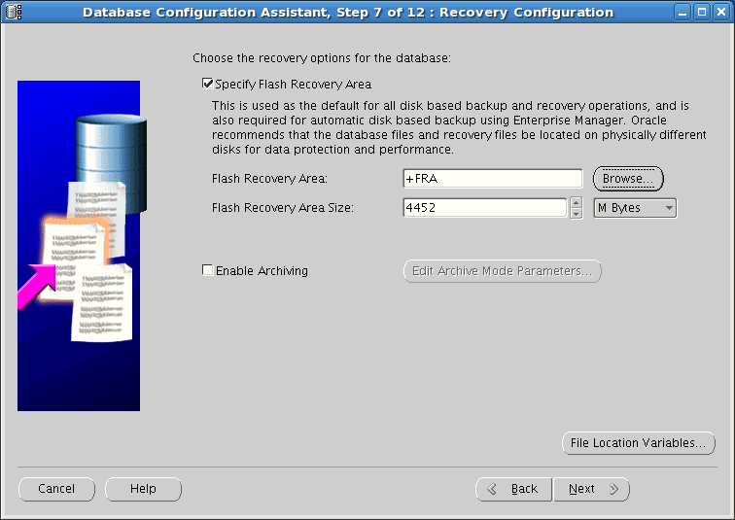
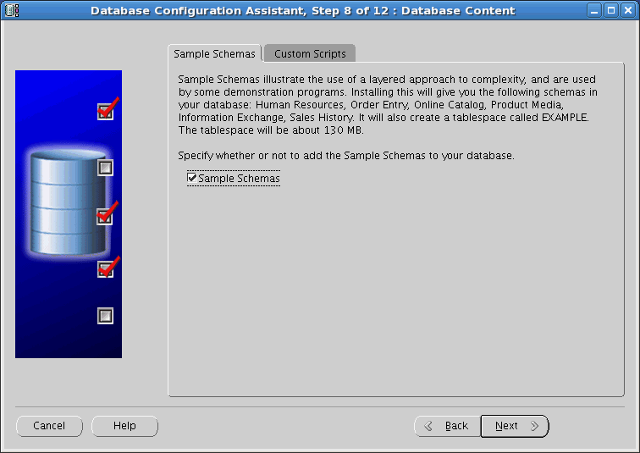
Using the DBCA to Create a Database
8
9
Notes:
Oracle Database 11g: Administration Workshop I 3 - <number>
Using the DBCA to Create a Database (continued)
8. Recovery Configuration: Choose the recovery options for you database. To configure the fast recovery area check the Specify Flash Recovery Area option and then specify the location and size of the fast recovery area. In the example shown on the location of the fast recovery area is set to use the +FRA ASM disk group and the size is 4452 MB. It is recommended that the size of your fast recovery area be larger than the size of your database. Archiving and archiving related parameters can also be configured from this screen
Note: The flash recovery area has been renamed to fast recovery area but you may still see references to flash recovery area within some Oracle products at this time.
9. Database Content: This pages provide options for selecting components (such as Sample Schemas) and a tab where you can specify any custom scripts that should be run after the database has been created.

Slide 14
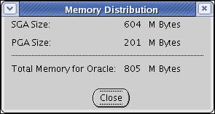
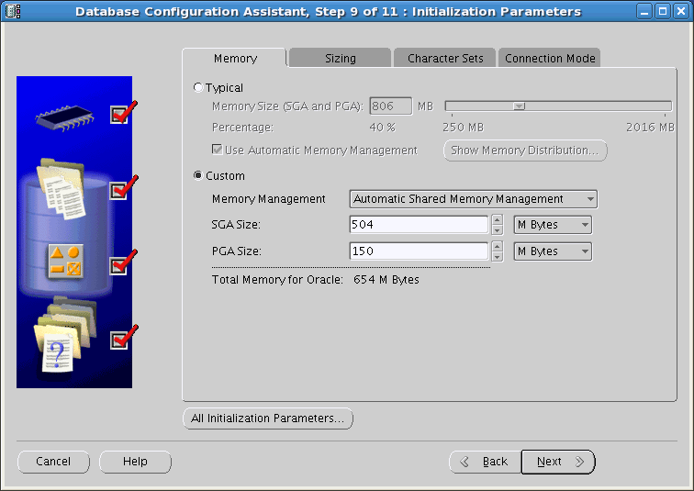
Using the DBCA to Create a Database
A
10
B
View and alter initialization parameters.
Notes:
Oracle Database 11g: Administration Workshop I 3 - <number>
Using the DBCA to Create a Database (continued)
10. Initialization Parameters: The tabs on this page provide access to pages that enable you
to change default database settings:
Memory: Use this page to set the initialization parameters that control memory usage. Use either (A) Typical or (B) Custom memory allocation.
Sizing: To specify block size, enter the size in bytes or accept the default.
Character Sets: Use this page to specify the character sets for your database.
Best Practice Tip: Oracle Corporation recommends (whenever possible) that you use Unicode for a database character set because it provides optimal flexibility for supporting Web technologies as well as many spoken languages.
Connection Mode: Select Dedicated or Shared Server Mode. For more details, see the lesson titled “Configuring the Oracle Network Environment.”
View and modify any initialization parameters by clicking the All Initialization Parameters button.
Note: Several initialization parameters are set for the lifetime of a database, such as the DB_BLOCK_SIZE parameter.

Slide 15
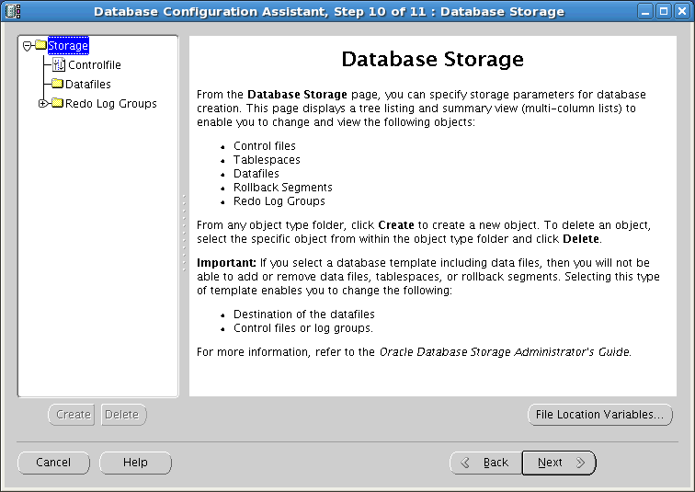
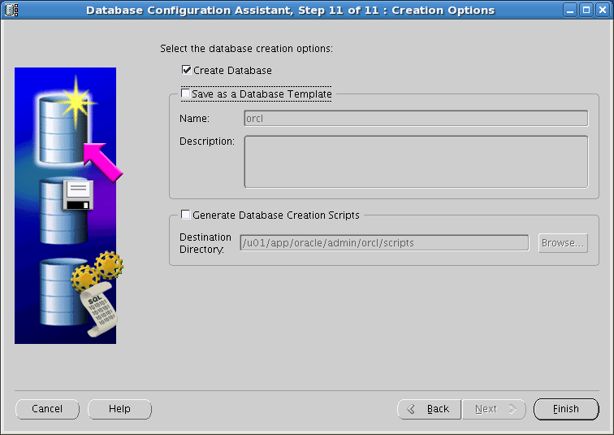
Using the DBCA to Create a Database
11
12
Notes:
Oracle Database 11g: Administration Workshop I 3 - <number>
Using the DBCA to Create a Database (continued)
11. Database Storage: Review and modify, if necessary, the current database storage settings. If you selected one of the preconfigured templates for a database, you cannot add or remove control files or data files.
12. Create Options: You have the following options: create your database at this time, save the database definition as a template, and generate scripts. If you choose all options and click Finish, the DBCA first saves the database template, then generates the scripts into your destination directory, and finally creates your database.

Slide 16
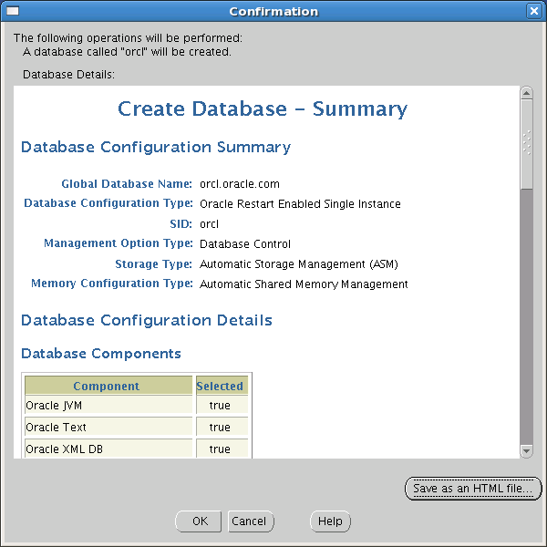
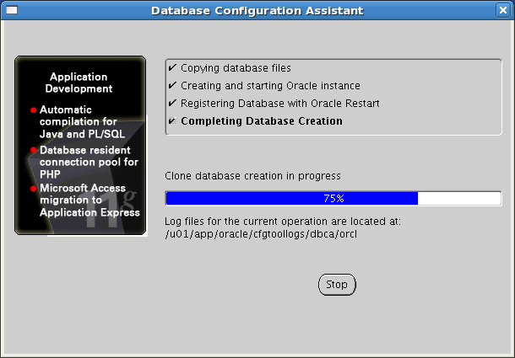
Create Database Summary
13
Notes:
Create Database Summary
13. A Confirmation page appears after you click Finish allowing you to review all the configuration of the database prior to creation. Click OK to dismiss the Confirmation page and begin creation of the database.
Note: You may want to save your database definition as an HTML file for easy reference.

Slide 17
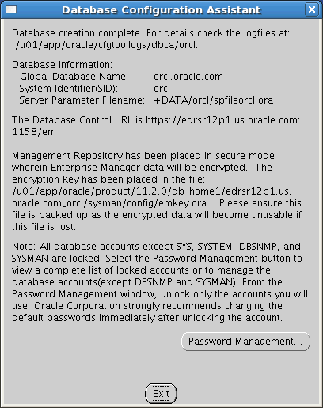
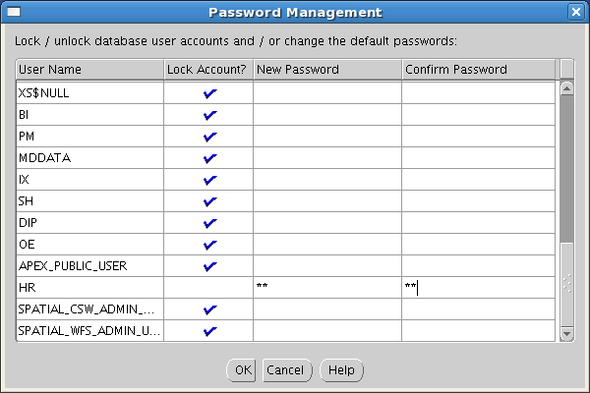
Password Management
14
Notes:
Password Management
14. After the DBCA finishes, note the following information for future reference:
Location of installation log files
Global database name
System identifier (SID)
Server parameter file name and location
Enterprise Manager URL
Click Password Management to unlock database accounts that you plan to use. Provide a password when you unlock an account. Any accounts not unlocked at this time can be unlocked later as required.

Slide 18
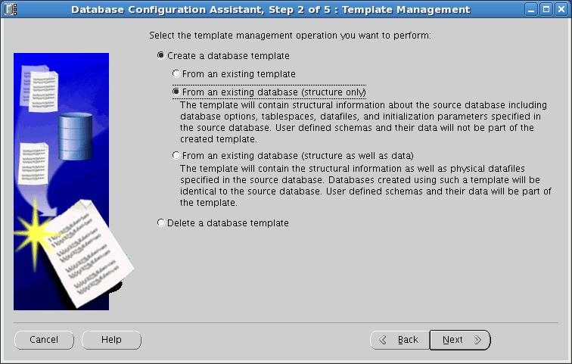
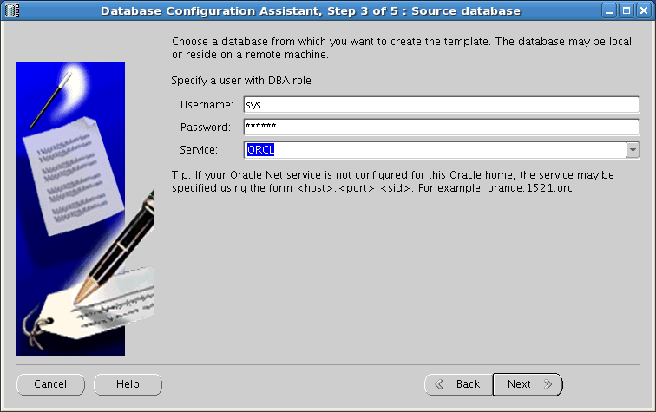
Creating a Database Design Template
Notes:
Creating a Database Design Template
A template is a predefined database definition that you use as a starting point for a new database. If you do not create a template as part of the database creation process, you can do it at any time by invoking the DBCA and choosing the Manage Templates operation.
There are three ways to create a template:
From an existing template
From an existing database (structure only)
From an existing database (structure as well as data)
The DBCA guides you through the steps to create a database design template.
If you no longer need a specific template use the “Delete a database template” option on the Template Management page of the DBCA.
Note: Templates you created will appear in the Database Templates list when you create a new database using the DBCA.

Slide 19
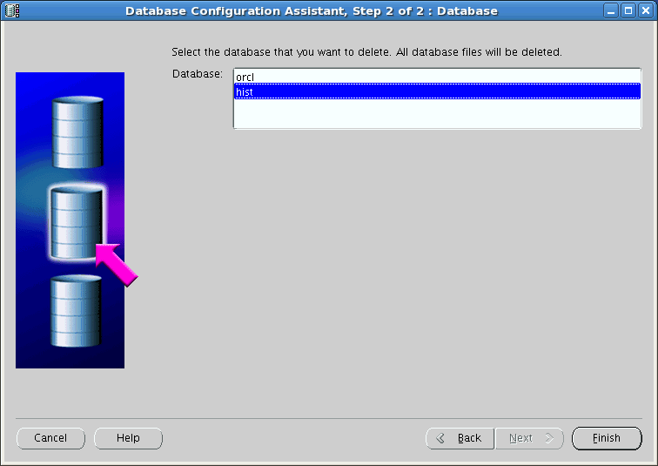
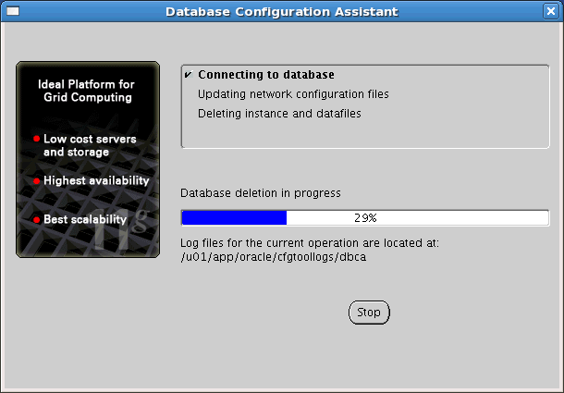
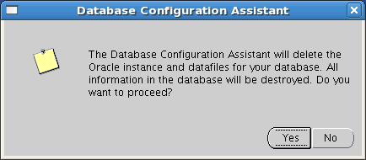
Using the DBCA to Delete a Database
Notes:
Using the DBCA to Delete a Database
Start the DBCA by entering dbca in a terminal window, and click Next on the Welcome page. To delete the database, perform the following steps:
1. On the Operations page, select Delete a Database. Then click Next.
2. Select the database that you want to delete (in this example, hist), and click Finish.
3. Click Yes to confirm your deletion.
4. When the deletion is completed, you will be asked whether you want to perform another operation. Answer accordingly.
Note: The database being deleted must be up and running so that DBCA can connect to the database to determine file location information.

Slide 20
Notes:
Using the DBCA to Delete a Database (continued)
Dropping a database involves removing its data files, redo log files, control files, and initialization parameter files. You can drop a database manually using the DROP DATABASE SQL statement. The DROP DATABASE statement deletes all control files and all other database files listed in the control file. To use the DROP DATABASE statement successfully, all of the following conditions must apply:
The database must be mounted and closed.
The database must be mounted exclusively (not in shared mode).
The database must have been started in RESTRICT mode.
An example of these statements are:
STARTUP RESTRICT FORCE MOUNT;
DROP DATABASE;
The DROP DATABASE statement has no effect on archived log files, nor does it have any effect on copies or backups of the database. It is best to use Recovery Manager (RMAN) to delete such files. If the database is on raw disks, the actual raw disk special files are not deleted.

Slide 21
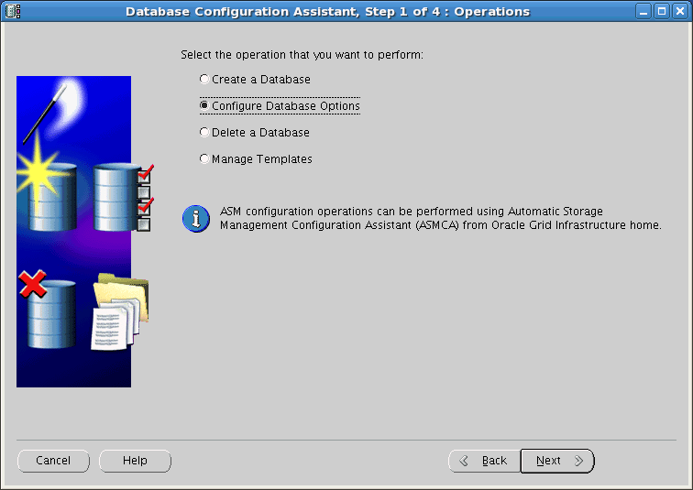
Using the DBCA for Additional Tasks
Notes:
Using the DBCA for Additional Tasks
You can use the DBCA to configure Database Options (such as Oracle Label Security or Oracle Database Vault). Not all options are installed by default during database software installation so these options will have to be installed prior to attempting to configure a database to use the options.
Note
For more information about Oracle Label Security, see the Oracle Label Security Administrator’s Guide.
For more information about Oracle Database Vault, see the Oracle Database Vault Administrator’s Guide.

Slide 22
Quiz
The parameter DB_BLOCK_SIZE is set for the lifetime of a database and cannot be changed.
  True
  False
Notes:
Answer: 1

Slide 23
Quiz
In order to drop a database using the DROP DATABASE command, the database must be:
  Open and in RESTRICT mode
  Mounted exclusively in RESTRICT mode
  Shut down with the immediate option
Notes:
Answer: 2

Slide 24
Summary
In this lesson, you should have learned how to:
  Create a database by using the Database Configuration Assistant (DBCA)
  Generate database creation scripts with the DBCA
  Manage database design templates with the DBCA
  Perform additional tasks with the DBCA

Slide 25
Practice 3 Overview:
Using the DBCA
This practice covers the following topics:
  Creating the ORCL database by using the DBCA
  Unlocking the HR schema
Note: Completing database creation and unlocking the HR schema are critical for all following practices.
  Creating the ORCL database design template by using the DBCA
  Creating database creation scripts by using the DBCA
Notes:
Oracle Database 11g: Administration Workshop I 3 - <number>

